Slide 1
Outline
Introduction
Background
Distributed Database Design
Database Integration
Semantic Data Control
Distributed Query Processing
Overview
Query decomposition and localization
Distributed query optimization
Multidatabase Query Processing
Distributed Transaction Management
Data Replication
Parallel Database Systems
Distributed Object DBMS
Peer-to-Peer Data Management
Web Data Management
Current Issues

Slide 2
Query Processing in a DDBMS
high level user query
query
processor
Low-level data manipulation
commands for D-DBMS

Slide 3
Query Processing Components
Query language that is used
SQL: “intergalactic dataspeak ”
Query execution methodology
The steps that one goes through in executing high-level (declarative) user queries.
Query optimization
How do we determine the “best” execution plan?
We assume a homogeneous D-DBMS

Slide 4
Selecting Alternatives
SELECT ENAME
FROM EMP,ASG
WHERE EMP.ENO = ASG.ENO
AND RESP = "Manager"
Strategy 1
Π _{ENAME}(EMP ⋈_{ENO} (σ_{RESP=“Manager”} (ASG))
Strategy 2
Π_{ENAME}(σ_{RESP=“Manager”∧EMP.ENO=ASG.ENO}(EMP×ASG))
Strategy 1 avoids Cartesian product, so may be “better”

Slide 5
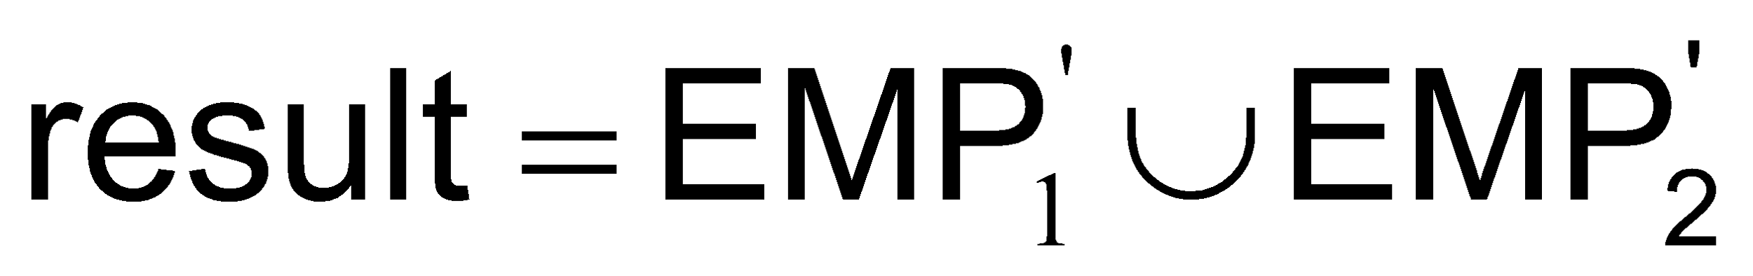
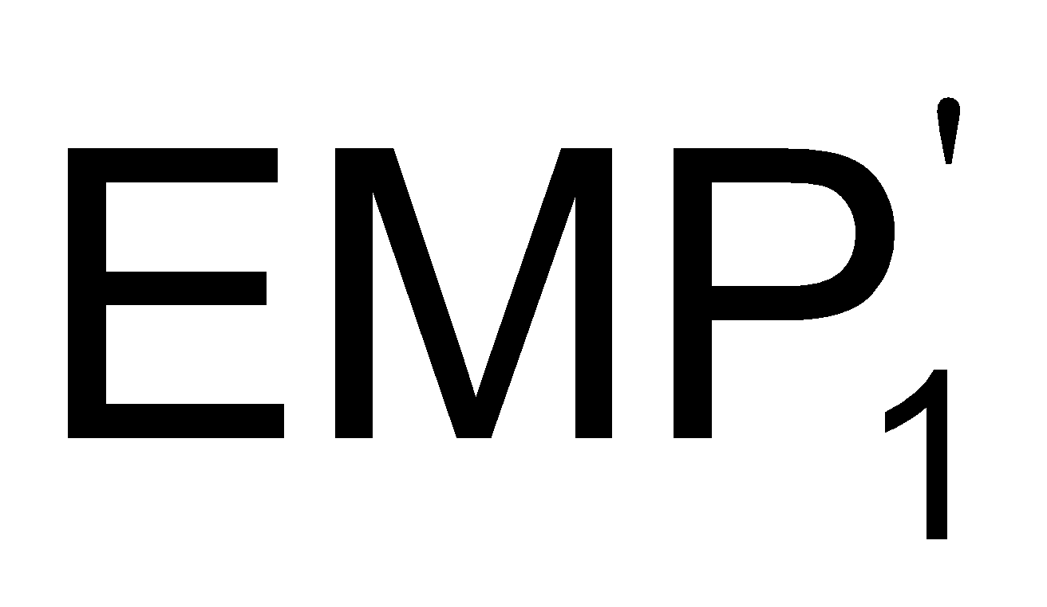
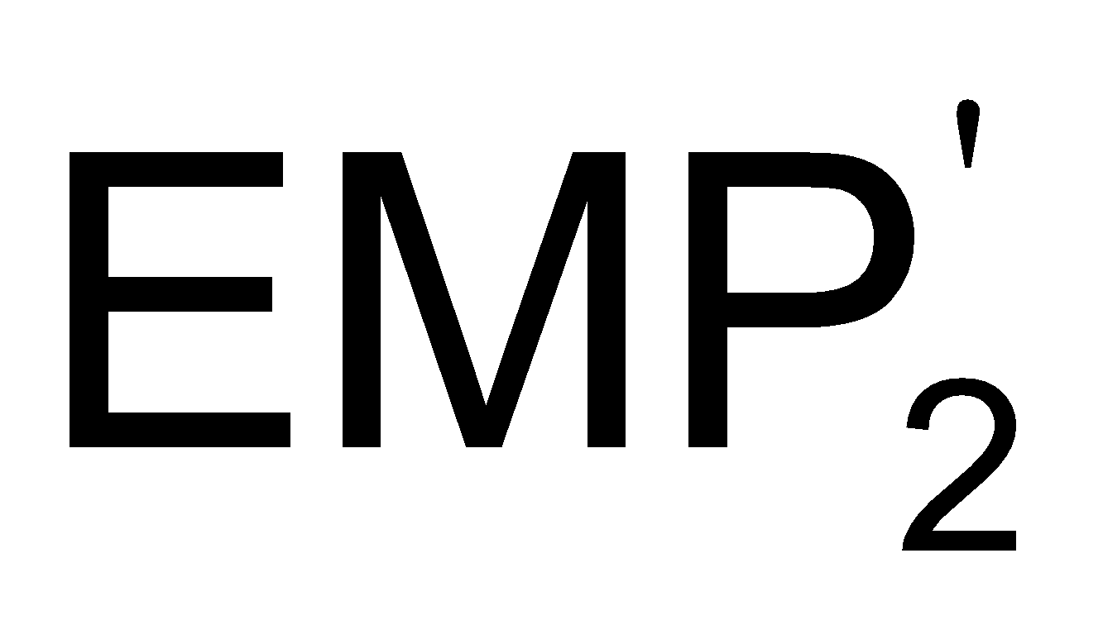
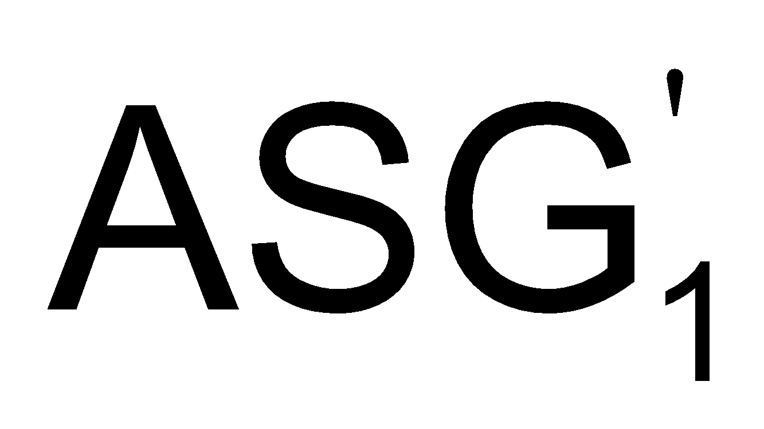
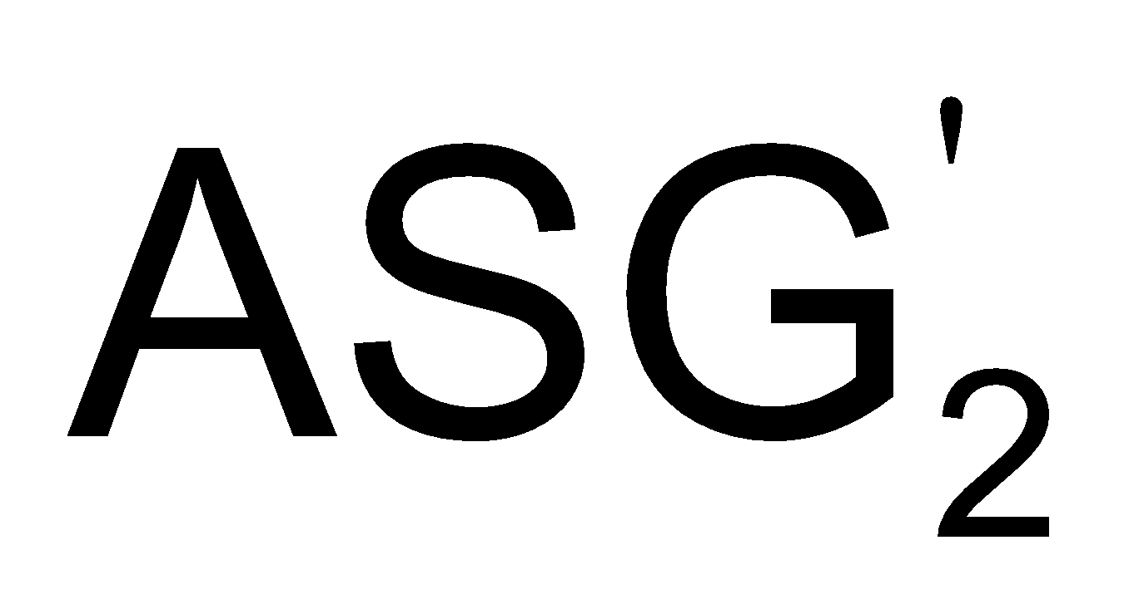
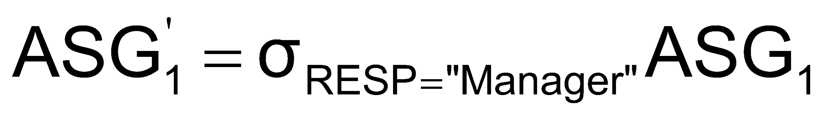
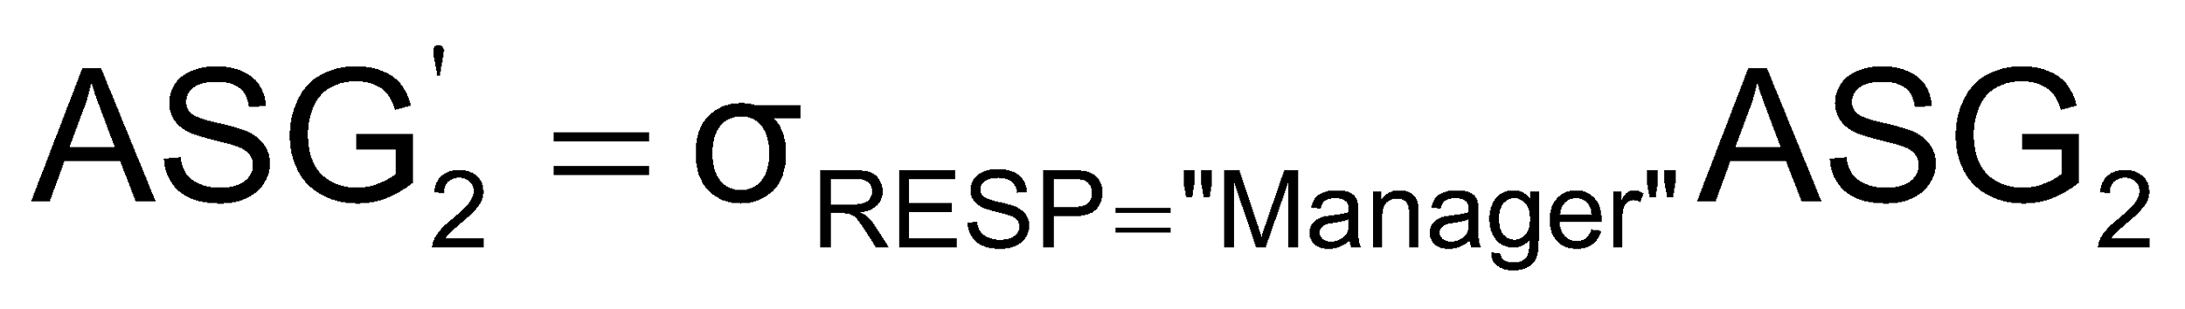
What is the Problem?
Site 1
Site 2
Site 3
Site 4
Site 5
ASG₁=σ_{ENO≤“E3”}(ASG)
ASG₂= σ_{ENO>“E3”}(ASG)
EMP₁= σ_{ENO≤“E3”}(EMP)
EMP₂= σ_{ENO>“E3”}(EMP)
Result
Site 5
Site 5
result= (EMP₁ ⋅ EMP₂)⋈_{ENO}σ_{RESP=“Manager”}(ASG₁× ASG₂)
Site 3
Site 4
ASG₁
ASG₂
EMP₁
EMP₂
EMP’₁=EMP₁ ⋈_{ENO} ASG’₁
EMP’₂=EMP₂ ⋈_{ENO} ASG’₂
Site 1
Site 2
Site 3
Site 4
Site 1
Site 2

Slide 6
Cost of Alternatives
Assume
size(EMP) = 400, size(ASG) = 1000
tuple access cost = 1 unit; tuple transfer cost = 10 units
Strategy 1
produce ASG': (10+10) * tuple access cost 20
transfer ASG' to the sites of EMP: (10+10) * tuple transfer cost 200
produce EMP': (10+10) * tuple access cost * 2 40
transfer EMP' to result site: (10+10) * tuple transfer cost 200
Total Cost 460
Strategy 2
transfer EMP to site 5: 400 * tuple transfer cost 4,000
transfer ASG to site 5: 1000 * tuple transfer cost 10,000
produce ASG': 1000 * tuple access cost 1,000
join EMP and ASG': 400 * 20 * tuple access cost 8,000
Total Cost 23,000

Slide 7
Query Optimization Objectives
Minimize a cost function
I/O cost + CPU cost + communication cost
These might have different weights in different distributed environments
Wide area networks
communication cost may dominate or vary much
bandwidth
speed
high protocol overhead
Local area networks
communication cost not that dominant
total cost function should be considered
Can also maximize throughput

Slide 8
Complexity of Relational Operations
Operation
Complexity
Select
Assume
relations of cardinality n
sequential scan
Project
O(n)
(without duplicate elimination)
Project
(with duplicate elimination)
O(n * log n)
Group
Join
Semi-join
O(n * log n)
Division
Set Operators
Cartesian Product
O(n²)

Slide 9
Query Optimization Issues – Types Of Optimizers
Exhaustive search
Cost-based
Optimal
Combinatorial complexity in the number of relations
Heuristics
Not optimal
Regroup common sub-expressions
Perform selection, projection first
Replace a join by a series of semijoins
Reorder operations to reduce intermediate relation size
Optimize individual operations

Slide 10
Query Optimization Issues – Optimization Granularity
Single query at a time
Cannot use common intermediate results
Multiple queries at a time
Efficient if many similar queries
Decision space is much larger

Slide 11
Query Optimization Issues – Optimization Timing
Static
Compilation 🡺 optimize prior to the execution
Difficult to estimate the size of the intermediate results⇒error propagation
Can amortize over many executions
R*
Dynamic
Run time optimization
Exact information on the intermediate relation sizes
Have to reoptimize for multiple executions
Distributed INGRES
Hybrid
Compile using a static algorithm
If the error in estimate sizes > threshold, reoptimize at run time
Mermaid

Slide 12
Query Optimization Issues – Statistics
Relation
Cardinality
Size of a tuple
Fraction of tuples participating in a join with another relation
Attribute
Cardinality of domain
Actual number of distinct values
Common assumptions
Independence between different attribute values
Uniform distribution of attribute values within their domain

Slide 13
Query Optimization Issues – Decision Sites
Centralized
Single site determines the “best” schedule
Simple
Need knowledge about the entire distributed database
Distributed
Cooperation among sites to determine the schedule
Need only local information
Cost of cooperation
Hybrid
One site determines the global schedule
Each site optimizes the local subqueries

Slide 14
Query Optimization Issues – Network Topology
Wide area networks (WAN) – point-to-point
Characteristics
Low bandwidth
Low speed
High protocol overhead
Communication cost will dominate; ignore all other cost factors
Global schedule to minimize communication cost
Local schedules according to centralized query optimization
Local area networks (LAN)
Communication cost not that dominant
Total cost function should be considered
Broadcasting can be exploited (joins)
Special algorithms exist for star networks

Slide 15
Distributed Query Processing Methodology
Calculus Query on Distributed Relations
Query
Decomposition
GLOBAL
SCHEMA
Algebraic Query on Distributed
Relations
CONTROL
SITE
FRAGMENT
SCHEMA
Data
Localization
Fragment Query
Global
Optimization
STATS ON
FRAGMENTS
Optimized Fragment Query
with Communication Operations
LOCAL
SITES
Local
Optimization
LOCAL
SCHEMAS
Optimized Local Queries

